Slide 1
An Introduction to JUnit Part 1: The Basics
Prepared by Chala Urgessa

Slide 2
JUnit – Java Unit Testing Tool
A unit testing tool for Java programs
JUnit home page: http://junit.org
A simple framework to write repeatable tests
Test cases, test suites, assertions, etc.,
Automated execution of test suites
Run all test cases, generate reports
Development methodology neutral
Often used in agile development/test-driven development

Slide 3
JUnit 5
Requires Java 8 (or higher) at runtime
Can still test code that has been compiled with previous versions of the JDK
Supported by popular IDEs
IntelliJ IDEA
Eclipse
NetBeans
Visual Studio Code
Supported by build tools
Gradle
Maven
Ant
Notes:
Current version 4.11 (Jan, 2014)

Slide 4
Running JUnit
JUnit has been integrated into most IDE’s
We will use the latest Intellij IDE
Download and install Intellij IDE for Java Developers
JUnit can also be run independently
Command-line, builder server
Using a simple build tool Ant
You can use both methods of running JUnit.

Slide 5
Test Case Verdicts
A verdict is the result of executing a single test case.
Pass
The test case execution was completed
The function being tested performed as expected
Fail
The test case execution was completed
The function being tested did not perform as expected
Error
The test case execution was not completed, due to
an unexpected event, exceptions, or
improper set up of the test case, etc.

Slide 6
JUnit Tests
A JUnit test is represented as a class (test class).
Each test case is a method in a test class.
A typical test case does the following
create some objects/data to test
do something interesting with the objects
determine pass or fail based on the results
A test suite may consist of multiple test classes.

Slide 7
JUnit Assertions
Assertions are Boolean expressions
An AssertionFailedError is thrown if the assertion is false
Can check for many conditions, such as
equality of objects and values
identity of references to objects
Determine the test case verdict
Pass: all assertions are true
Fail: one or more assertions are false

Slide 8
A Simple JUnit Test Case
/** Test of setName() method, of class Value */
@Test
public void createAndSetName() {
Value v1 = new Value();
v1.setName("Y");
String expected = "Y";
String actual = v1.getName();
Assert.assertEquals(expected, actual);
}

Slide 9
A Simple JUnit Test Case
/** Test of setName() method, of class Value */
@Test
public void createAndSetName() {
Value v1 = new Value();
v1.setName("Y");
String expected = "Y";
String actual = v1.getName();
Assert.assertEquals(expected, actual);
}
Identify this Java method
as a test case

Slide 10
A Simple JUnit Test Case
/** Test of setName() method, of class Value */
@Test
public void createAndSetName() {
Value v1 = new Value();
v1.setName("Y");
String expected = "Y";
String actual = v1.getName();
Assert.assertEquals(expected, actual);
}
Confirm that setName
saves the specified name in the Value object

Slide 11
A Simple JUnit Test Case
/** Test of setName() method, of class Value */
@Test
public void createAndSetName() {
Value v1 = new Value();
v1.setName("Y");
String expected = "Y";
String actual = v1.getName();
Assert.assertEquals(expected, actual);
}
Check to see that the
Value object really
did store the name

Slide 12
A Simple JUnit Test Case
/** Test of setName() method, of class Value */
@Test
public void createAndSetName() {
Value v1 = new Value();
v1.setName("Y");
String expected = "Y";
String actual = v1.getName();
Assert.assertEquals(expected, actual);
}
Assert that the expected and actual should be equal. If not, the test case should fail.

Slide 13
Organization of JUnit Test
Each test method represents a single test case
can independently have a verdict (pass, error, fail).
The test cases for a class under test (CUT) are usually grouped together into a test class.
Naming convention:
Class under test: Value
JUnit test for the class: ValueTest
Test classes are sometimes placed in a separate package.

Slide 14
Using JUnit in Eclipse/NetBeans
Download and install JDK
Download and install Eclipse/NetBeans IDE for Java Developers
JUnit is included in Eclipse/NetBeans

Slide 15

Run JUnit in Eclipse: An Example
Contents of JUnit1
Download the Sample Code
JUnit1.rar
Unzip to the Eclipse
workspace folder
A subfolder named
JUnit1
The example contains
BinarySearch.java
BinarySearchTest.java
[see JUnit1.rar]

Slide 16
The Example Program: The Class Under Test
public class BinarySearch {
public static int search(int[] a, int x) {
…
}
public static int checkedSearch(int[] a, int x) {
…
}
}

Slide 17
The JUnit Test
public class BinarySearchTest {
@Test
public void testSearch1() {
int[] a = { 1, 3, 5, 7 };
assertTrue(search(a, 3) == 1);
}

Slide 18
The JUnit Test (cont’d)
@Test
public void testSearch2() {
int[] a = { 1, 3, 5, 7 };
assertTrue(search(a, 2) == -1);
}
@Test
public void testCheckedSearch1() { … }
@Test
public void testCheckedSearch2() { … }
@Test
public void testCheckedSearch3() { … }
}

Slide 19
Run JUnit in Eclipse: An Example
Start Eclipse IDE
New Java Project
Project name: JUnit1
Important: The project name matches the name of the folder that contains the sample code

Slide 20
Run JUnit in Eclipse: An Example
Click “Next”
Java Settings
Click “Libraries”
Click “Add Library …”

Slide 21
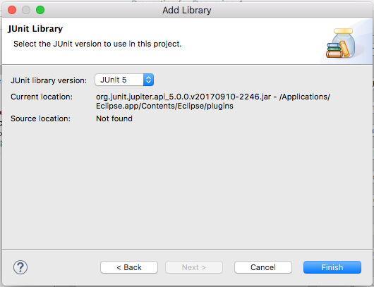
Run JUnit in Eclipse: An Example
Add Library
Choose “JUnit”
JUnit Library
Choose “JUnit 5”
Click “Finish”

Slide 22
Run JUnit in Eclipse: An Example
Run as
JUnit test

Slide 23
Run JUnit in Eclipse: An Example

